Slide 1
FY24 PEPFAR HRH Reporting Template DATIM Error Messages and Resolutions
September 2024

Slide 2
Overview of DATIM Validation Errors

Slide 3
Data Validations in DATIM HRH App
Data quality validations are validations that are processed only after uploading the template in DATIM. These validations check for values or logic that are not allowable in the template.
If you receive one of these errors, you can review the Row that the error is flagged for, and correct that row based on the error received. Once the row is updated, you can re-upload the template to DATIM, which will overwrite the file you previously uploaded.
The template can be uploaded as many times as needed to correct errors
If you have more than 50 errors, the individual errors will not display. Reach out to the help desk for assistance with your template.
The template must fully pass all validations in order to be accepted. After successful submission, you should then go to the separate Data Approvals app in DATIM and submit the data for approval.

Slide 4
Upload Status Examples
If your template is successfully uploaded, you will see the following status:
If there is an error in your uploaded template, you will see the following error status, along with the associated errors below:

Slide 5
DATIM Validations and Resolutions

Slide 6
Validations in DATIM
ID | Error
1 | Error: Prime UEI [Coversheet]: Cell D13 is missing Prime UEI and must be 12 numeric characters.
2 | Error: Sub UEI [Coversheet]: {Cells} is missing Sub UEI and must be 12 numeric characters
3 | Error: Invalid mechanism for this Operating Unit. Is your template up-to-date? Must use the latest template version.
4 | [Invalid Beneficiary] is not a valid Beneficiary for Implementation Year [period_id year + 1]" [Invalid Program Area] is not a valid Program Area for Implementation Year [period_id year + 1]"
5 | Error: Cells must contain fewer than 255 characters
6 | Error: Dropdown selections may not be populated with free-form text. Please select only options from the dropdown list.
7 | Error: If a row has data, the following columns must be populated: Column C-P, X, Y
8 | Error: Same record number cannot be used twice - please check column A of the Staff List
9 | Error: The template's mechanism and the mechanism selected in the app do not match. Please remove this file and either select the correct mechanism in the app, or fix the template and upload again.
10 | Error: Resource is indicated to be employed through a sub-contractor (column B). Please select sub-contractor name in "If Sub. Select IP Name" (column C). These names are populated on the Cover Sheet after adding Count of Subrecipients.
11 | Error: A ‘Non-Service Delivery’ associated employment title (column F) was selected for a position that was indicated as providing ‘Direct Service Delivery’ (column E). Please review and correct.
12 | Error: A ‘Service Delivery' associated employment title (column F) was selected for a position that was indicated as a 'Non-Service Delivery' (column E). Please review and correct.

Slide 7
Validations in DATIM
ID | Error
13 | Error: Resource has a technical assistance employment title (column F). “Delivers services directly to beneficiaries (column E) must be “Non-Service Delivery"
14 | Error: Position is indicated to support work in the community (column N). Employment title (column F) must be a position that can work in the community.
15 | Error: Resource in Row # has an Above-Site Primary Program Area (column H) and is Direct Service Delivery (column E). Above Site Program Areas cannot be Direct Service Delivery.
16 | Error: Resource in Row # has been indicated to work at facility level (Facility Geography column). Primary Program Area (column H) must be 'Site Level:…' or 'IP Program Management'.
17 | Error: "Resource in ROW # has been indicated to work at the Above Site level. Primary Program Area (column H) should begin with "IP Program Management” or “Above Site" OR a Facility needs to be selected if this resource works at the Facility Level.
18 | Error: Primary Program Area was selected as Above Site or IP Program Management in Row # AND providing Direct Service Delivery. Please review and correct either Primary Program Area (column H) or Deliver Services DIRECTLY to Beneficiaries (Column E).
19 | Error: Resource has a technical assistance employment title (column F). Technical Assistance (column I) must be “YES”.
20 | Error: Number of months worked in year (column L) should be a number greater than zero (0) and less than or equal to twelve (12).
21 | Error: Average FTE per month (column M) should be less than or equal to 1.005
22 | Error: Position is indicated to be based outside of OU (column M). Geographic information should be left blank.
23 | Error: Resource is indicated to work in the community (column N). Work in/support multiple facilities (roving staff) (column O) must be “No.”
24 | Error: Resource is indicated to work in or support multiple sites (roving staff) (column O). Facility geography should be left blank.

Slide 8
Validations in DATIM
ID | Error
25 | Error: Position is indicated to be based inside the OU (column P). You must select the SNU1 (column Q) for this resource
26 | Error: Position is indicated to be based outside of OU (column P). Primary Program Area must be with "Above Site:.." Or "IP Program Management" (column H).
27 | Error: Invalid OU chain hierarchy. Please review SNU selections.
28 | Error: If Primary Program Area (column H) is SE, Primary Beneficiary (column X) cannot be Non-Targeted.
29 | Error: Expenditure (column Z), Fringe (column AA) and Non-Monetary Expenditures (column AB) must be between $0 - $1M.
30 | Error: Human resource in Row # has been indicated as Salaried or Contract (column J). Please review resource to ensure that salary (expenditure) (column Z) and/or Fringe (column AA) information is populated.
31 | Error: Human resource in Row # has been indicated as Non-Monetary ONLY (column J). Please review resource to ensure that only non-monetary expenditure (column AB) information is populated and column Z and column AA are zero or blank.
32 | Error: Human resource in [ROW #] has been indicated to work at Above Site Level and providing Direct Service Delivery. Please review and correct either Primary Program Area or Service Delivery.

Slide 9
1. Error: Prime UEI [Coversheet]: Cell D13 is missing or contains an invalid Prime UEI.
To fix this error, please populate the cell with a valid PRIME UEI that consists of 12 numeric characters.

Slide 10
2. Error: Sub UEI [Coversheet]: {Cells} is missing or contains an invalid Sub UEI.
To fix this error, please ensure you enter a valid Sub UEI that consists of 12 numeric characters.

Slide 11
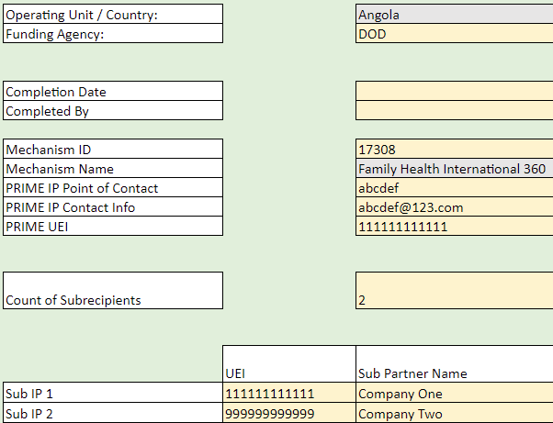
3. Error: Invalid mechanism for this Operating Unit. Is your template up-to-date?
To correct this error, ensure the Mechanism ID matches the mechanism you are uploading for within DATIM and that it is valid for the OU and COP year.
The OU, Mechanism ID, and Name are prepopulated from DATIM.

Slide 12
4. Error: Dropdown selections may not be populated with free-form text; Please select only options from the dropdown list.
This error can occur if you are copying and pasting from a prior years' template that uses values that are no longer valid for this Fiscal Year. Please ensure you are using a current template that uses the correct values for each field that has a dropdown option.
To fix this error, please ensure you are using valid values for every field that has a dropdown option.

Slide 13
5. Error: Cells must contain fewer than 255 characters
Ensure that all cells have less than the maximum amount of characters
To fix this error, please ensure your cell contains less than 255 characters and is a unique value.

Slide 14
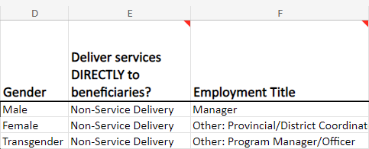
6. Error: Dropdown selections may not be populated with free-form text. Please select only options from the dropdown list.
All fields with dropdown menus must be populated with only options from the dropdown
Free text write-ins are not accepted
The ability to input free-form text will only be possible by copy and pasting between templates (which should be avoided)
To fix this error, please select an option from the dropdown menu and avoid copy and pasting if possible. If pasting, please ensure that the values are valid for the COP year.

Slide 15
7. Error: If a row has data, the following columns must be populated: Column B, D-P, X, Y
For any row with data, the following columns are required:
Column B
Columns D through P
Column X
Column Y
To fix this error, please ensure that columns B, D through P, X, and Y are populated.

Slide 16
8. Error: Same record number cannot be used twice - please check column A of the Staff List.
Column A of the template is an optional column for the staff Record Number
However, the IDs in this column, if present, are checked for uniqueness
To fix this error, please ensure your cell is a unique value and contains less than 255 characters.

Slide 17
9. Error: The template's mechanism and the mechanism selected in the app do not match. Please remove this file and either select the correct mechanism in the app, or fix the template and upload again.
To correct this error, download the correct template associated with the desired Mechanism ID and refill the data.

Slide 18
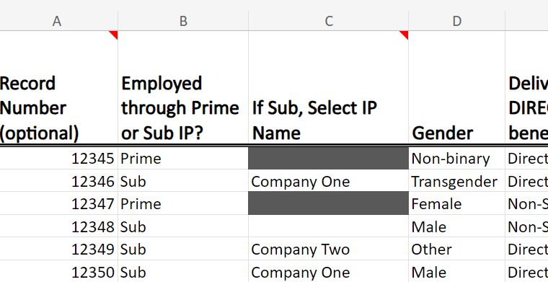
10. Error: Resource is indicated to be employed through a sub-contractor (column B). Please select sub-contractor name in column C.
If a resource is indicated to be Sub in column B, a sub-contractor name must be selected in Column C. This error can also trigger if you select Prime in Column B, but still select a Sub IP Name in Column C (Column C should be blank if Prime).
To fix this error, please select a Sub IP from the dropdown. To populate Sub IPs, make sure the coversheet has the name of your Sub IPs listed.

Slide 19
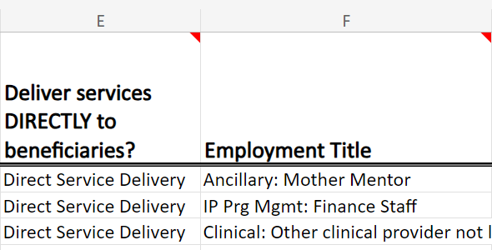
11. Error: A ‘Non-Service Delivery’ associated employment title (column F) was selected for a position that was indicated as providing ‘Direct Service Delivery’ (column E). Please review and correct.
If a resource is indicated to be “Non-Service Delivery” in Column E, their employment title must be a non-service delivery related job title and cannot be indicated as Providing Direct Service Delivery
The mappings for Direct Service Delivery and Non-Service Delivery job titles are available at: HRH Handbook (Appendix H)
To fix this error, please review the mappings for Direct Service Delivery and Non-Service Delivery job titles above and update to a valid combination.

Slide 20
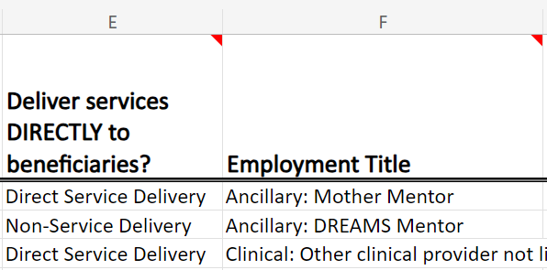
12. Error: A ‘Direct Service Delivery' associated employment title (column F) was selected for a position that was indicated as a 'Non-Service Delivery' (column E). Please review and correct.
If a resource is indicated to have an employment title associated with Service Delivery in Column F, their job title must be Listed as "Direct Service Delivery" in column E
The mappings for Direct Service Delivery and Non-Service Delivery job titles are available at: HRH Employment Title/Category/Cadre
To fix this error, please review the mappings for Direct Service Delivery and Non-Service Delivery job titles above.

Slide 21
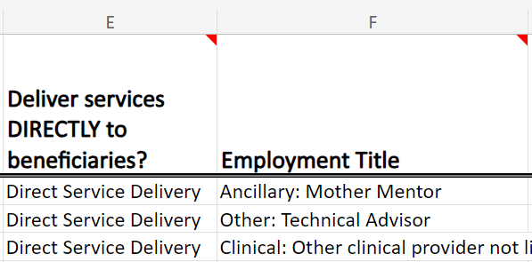
13. Error: Resource has a technical assistance employment title (column F). “Delivers services directly to beneficiaries (column E) must be “Non-Service Delivery”.
To correct this error, either change the Employment Title to one that can be Direct Service Delivery or change the service delivery to Non-Service Delivery

Slide 22
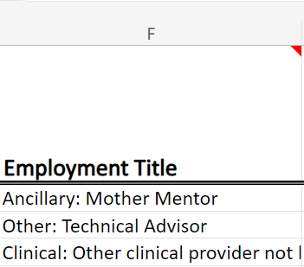
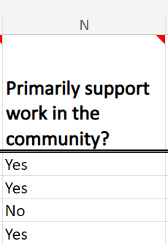
14. Error: Position is indicated to support work in the community (column N). Employment title (column F) must be a position that can work in the community.
To correct this error, change Employment Title to one that can work in the Community or change column N to 'No'.

Slide 23
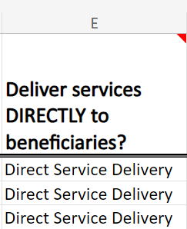
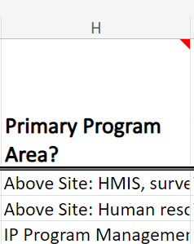
15. Error: Resource in Row # has an Above-Site Primary Program Area (column H) and is Direct Service Delivery (column E). Above Site Program Areas cannot be Direct Service Delivery.
To correct this error, change the Primary Program Area to a Direct Service.

Slide 24
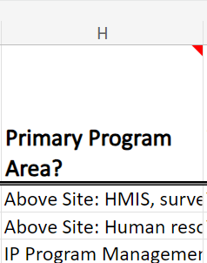
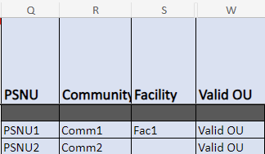
16. Error: Resource in Row # has been indicated to work at facility level (Facility Geography column). Primary Program Area (column H) should begin with "Site Level: ... or be IP Program Management
To fix this error, please ensure that if a Facility is indicated in Column S (i.e. Column S is not blank), the Primary Program Area indicated in Column H must be a “Site Level” Program Area

Slide 25
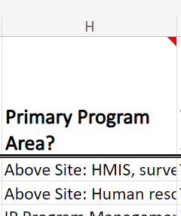
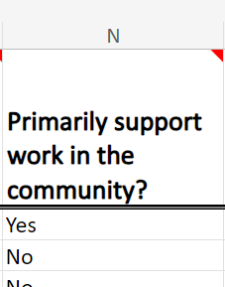
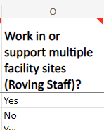
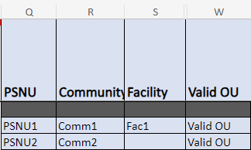
17. Error: "Resource in ROW # has been indicated to work at the Above Site Level. Primary Program Area (column H) should begin with "IP: Program Management” or “Above Site." OR a Facility needs to be selected if this resource works at the Facility Level
To correct this error, change the Primary Program Area to 'IP Program Management' or 'Above Site' OR add a 'Facility'.

Slide 26
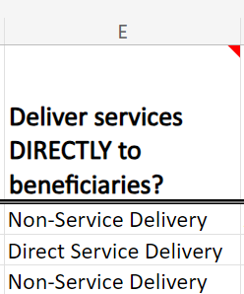
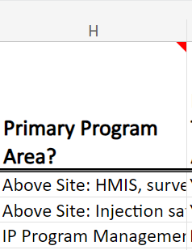
18. Error: Primary Program Area was selected as Above Site or IP Program Management in Row # AND providing Direct Service Delivery. Please review and correct either Primary Program Area (column H) or Deliver Services DIRECTLY to Beneficiaries (Column E).
To correct this error, change Primary Program Area to 'Site Level:..' Or column E to 'Non-Service Delivery'

Slide 27
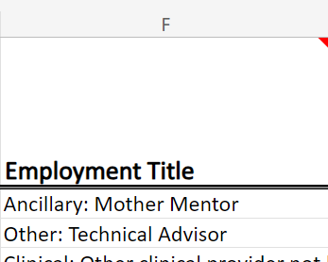
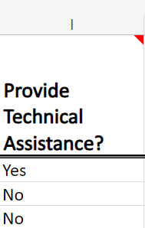
19. Error: Resource has a technical assistance associated job title (column F). Technical Assistance (column I) must be “YES”.
To correct this error, change column I to 'Yes'.

Slide 28
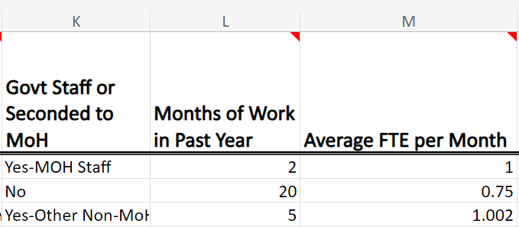
20. Error: Number of months worked in year (column L) should be a number greater than zero (0) and less than or equal to twelve (12).
Values entered in Column G of the template, “Months of Work in the Past Year”, must be more than 0 but cannot exceed 12
To fix this error, the Number of Months worked should be a whole number greater than zero (0) and less than or equal to twelve (12).

Slide 29
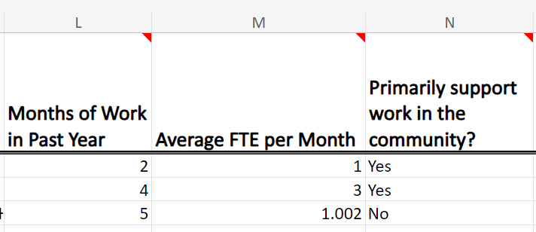
21. Error: Average FTE per month (column M) should be less than or equal to 1.005
Values entered in Column H of the template, “Average FTE per Month”, cannot exceed 1.005
To fix this error, the Average FTE per month should be greater than zero (0) and less than or equal to 1.005.

Slide 30
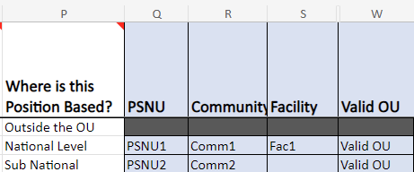
22. Error: Position is indicated to be based outside of OU (column P). Geographic information should be left blank.
The above entry will be flagged upon upload if geographic information is uploaded under the shaded section and give the above error message in the HRH app.
To fix this error, ensure that there are no characters in the shaded columns. To remove text, select the cell with text and click 'delete'.

Slide 31
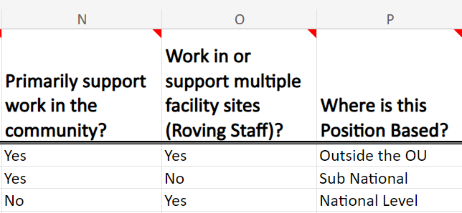
23. Error: Resource is indicated to work in the community (column N). Work in/support multiple facilities (column O) must be “No.”
To fix this error, change column O to 'No'.

Slide 32
24. Error: Resource is indicated to work in or support multiple sites (roving staff) (column O). Facility geography should be left blank.
To fix this error, if column O is "Yes", ensure that the Facility column is blank. If there is information entered, click the cell with text and click 'delete'.

Slide 33
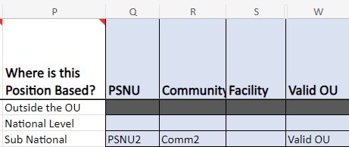
25. Error: Position is indicated to be based at the National Level (column P). You must select the SNU1 (column Q) for this resource.
To correct this error, if National Level is selected in column P, ensure that you have selected an PSNU in column Q and 'Valid' is shown under 'Valid OU'.

Slide 34
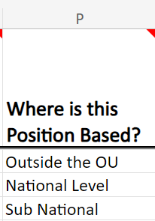
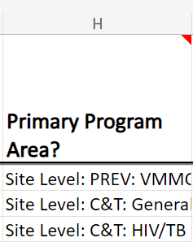
26. Error: Position is indicated to be based outside of OU (column P). Program Area must begin with Above Site or IP: Program Management (column H).
To correct this error, change the position or the Primary Program Area to Above Site or IP: Program Management.

Slide 35
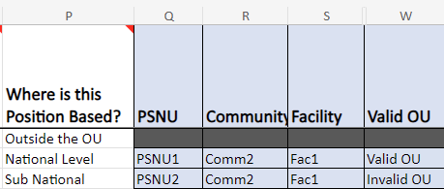
27. Error: Invalid OU chain hierarchy. Please review SNU selections.
To correct this error, change the hierarchy to a valid sequence.

Slide 36
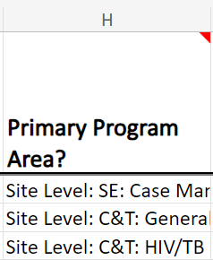
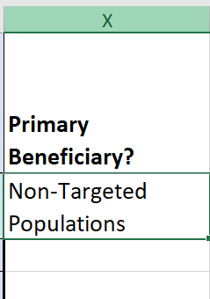
28. Error: If Primary Program Area (column H) is SE, Primary Beneficiary (column X) cannot be Non-Targeted.
To correct this error, change the Primary Program Area to a non-SE area or change the Primary Beneficiary to a targeted population.

Slide 37
29. Error: Expenditure (column Z), Fringe (column AA) and Non-Monetary Expenditures (column AB) must be between $0M-$1M.
To fix this error, please ensure that values in Columns Z, AA, and AB are numeric values between $0-$1,000,000.

Slide 38
30. Error: Human resource in Row # has been indicated as Salaried or Contract (column J). Please review resource to ensure that both salary (expenditure) (column Z) and/or fringe information (column AA) is populated.
For any resource indicated as “Salary” or "Contract" for Mode of Hire in Column J, either Column Z or Column AA (or both) must contain a value.
To fix this error, please review resource to ensure that Column Z (Sum of Annual PEPFAR Expenditure) and/or Column AA (Fringe Expenditure) have a value.”

Slide 39
31. Error: Human resource in Row # has been indicated as Non-Monetary ONLY (column J). Please review resource to ensure that only non-monetary expenditure (column AB) information is populated. And column Y and column Z are zero or blank.
For any resource indicated as “Non-Monetary Only” for Mode of Hire in Column J, both salary and fringe must be blank and the only expenditure should be in Column AB
To fix this error, please review resource indicated as “Non-Monetary Only” for Mode of Hire in Column J and ensure that both salary and fringe must be blank and the only expenditure should be in Column AB.

Slide 40
32. Error: Human resource in [ROW #] has been indicated to work at Above-Site Level and providing Direct Service Delivery. Please review and correct either Primary Program Area or Service Delivery.
If a resource is indicated to work within an Above-Site Primary Program Area, Deliver services DIRECTLY to beneficiaries? must be “Non-Service Delivery”
To fix this error, please change the Primary Program Area to Site Level or IP: Program Management or change the service delivery to Non-Service Delivery.

